Slide 1

Django Intro, models and Admin interface
Web 3

Slide 2
What is Django?
A high-level Python Web framework that encourages rapid development and clean, pragmatic design
What is a web framework?
A web framework is a collection of tools used to build websites or web apps.
The tools that Django comes with are
Object-relational mapping, called an ORM, which helps make database queries
Django also comes with URL routing, which helps determine what logic to follow depending on the URL of a web request
HTML templating allows us to have presentation logic and to insert data into our HTML
Some other tools that come with Django are form handling, unit testing tools, as well as many others
Django is not a programming language!
Python is the programming language used when working with Django
Django is also not a web server.
It comes with a built-in one as a convenience for development, but when used outside of development as a real website, Django works with web servers such as Apache or Nginx

Slide 3
Django Project Structure
The normal Django workflow, starts a project with the command:
django-admin startproject [projectname]
__init__ is generated so that python will consider the folder to be a python module.
The role of the manage.py file is to run commands for our project
Inside of the first Django folder are the files wsgi.py, settings.py and urls.py.
The wsgi.py file is used by a web server to run the Django project.
The settings file is used to configure our project
the urls file configures what code is run when a request comes in based on the url path
projectname\
manage.py
projectname\
settings.py
urls.py
wsgi.py
__init__.py

Slide 4
Django App Structure
A project is composed of one or more apps
You can create an app within a project with the command
python manage.py startapp blog
The models file defines this data layer of the application, such as the structure of the database tables and how they are queried
The admin file defines the administrative interface for viewing and updating data for that application
The views file defines the program logic for that app and each one takes an http web request and returns an http response
The tests file defines automated tests on the code within that application
the migrations folder contains files that automate how database tables are created or changed over time for that app. These files are often auto-generated but can be created by hand
projectname\
manage.py
projectname\ settings.py
urls.py
wsgi.py
__init__.py
blog\
migrations\
init__.py
__init__.py
admin.py
models.py
tests.py
views.py

Slide 5
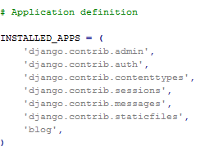
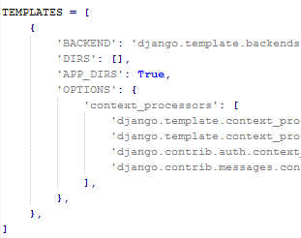

Django Settings.py
The INSTALLED_APPS
used for adding or removing apps from the project
The TEMPLATES
when we first add template files to our project.
STATICFILES_DIRS
when we add static assets such as CSS and JavaScript to our project
DEBUG
is best set to false when your web project is deployed
DATABASES
We're using the built in default database called SQLite, but if you want to use a production ready database such as PostgreSQL or MYSQL, you'll need to change the engine and name entries in the DATABASES setting

Slide 6
Django Models (models.py)
Typically, a Django app contains a models.py file
Create the data layer of an app
Define the structure of our data and how it will be stored in the database
Allows us to query data from the database
The models.py file contains any number of models.
A model is a class that inherits from django.db.models.Model.
Models use class attributes to define the fields for the given model.
As an analogy, we can conceptualize models as spreadsheets.
Each model is a table in a spreadsheet, while each field of the model is a column for that spreadsheet table.
Once our database is populated with data, we can think of each record in the database as a row in the spreadsheet.

Slide 7
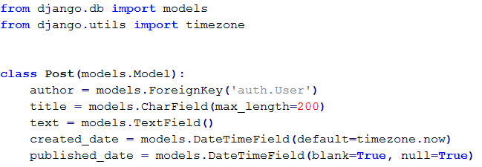
Django Models (models.py)

Slide 8
Field Types
IntegerField and DecimalField, for storing integers and decimal numbers respectively
Charfield: requires a max length attribute and stores an amount of characters up to that length
The TextField also stores text but differs from Charfield in that the length of the text is unbounded
EmailField
URLField
FileField
ImageField
BooleanField
DateTimeField

Slide 9
Creating and running migrations
While the django models define the expected structure of our database, Migrations are responsible for creating the necessary scripts to change this structure through time as we update our code and change our models
When a model is added to a models file, the corresponding database table does not exist yet. For this purpose, we need an initial migration whose role is to create that database table
Migrations are also needed when a field is added, or removed from an existing model, or when the attributes of a field have changed. All of these changes to a models file need a corresponding change to the database, and for this purpose, a migration needs to be created and run.

Slide 10
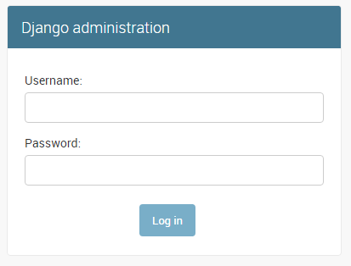
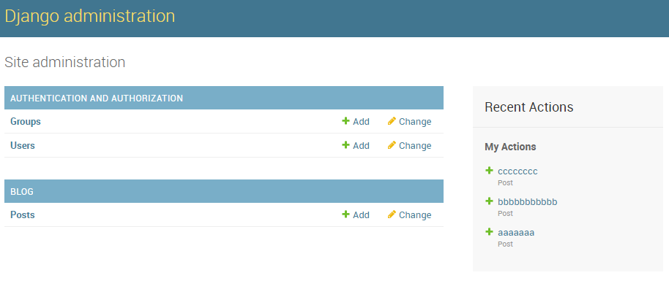
The Django admin
Built in Administration interface for our project

